Slide 1

Text Classification Using CNN
By
Srisailam Basanthpur
Data 606 Capstone in Data Science Under the Guidance of Prof. Dr. Chaojie Wang

Slide 2

Objective
Building a text classifier using CNN
Text input to predict Label.

Slide 3

Data
Raw Data - No rows and columns, rather data is present in text files.
19997 files
Cleaned
Processed using python regex.
20 unique class labels.

Slide 4
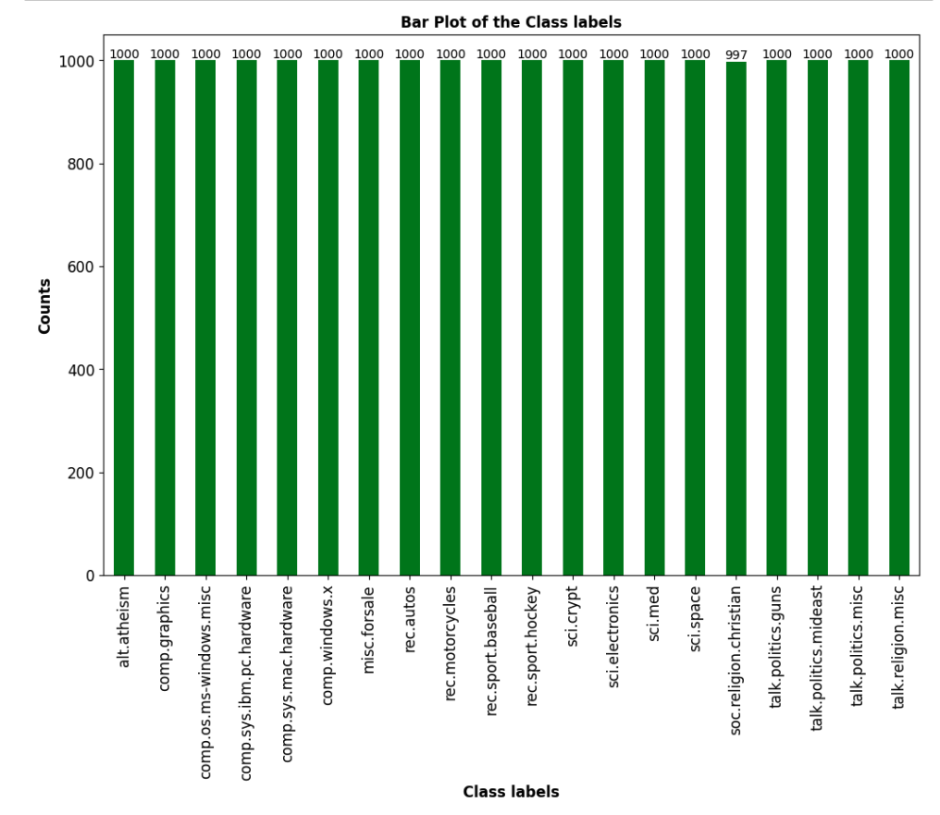
All class labels with equal no of documents.
997- religion.christian, Others – 1000.
Almost Balanced dataset.

Slide 5
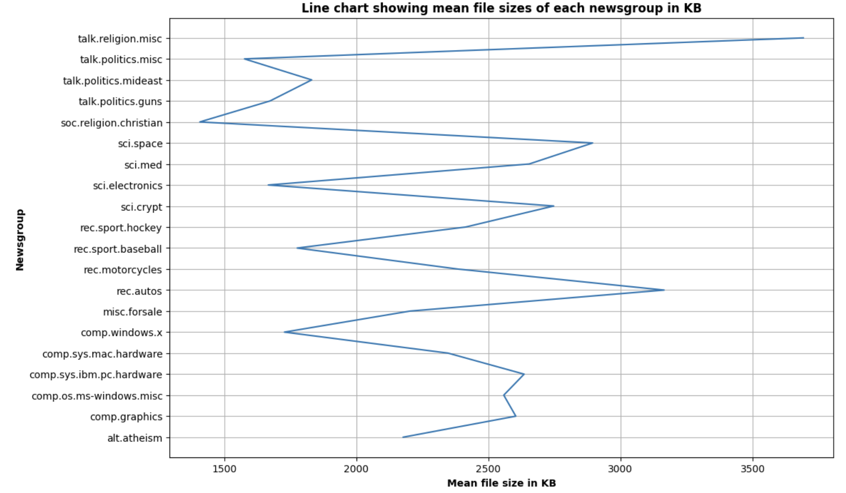
File Size
talk.religion.misc has got the highest mean file size.
soc.religion.christian has got the lowest mean file size.

Slide 6
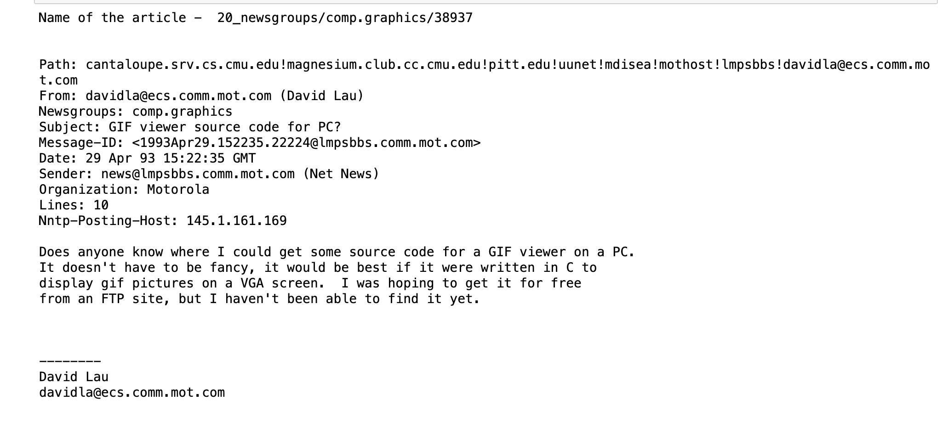
Random News article

Slide 7
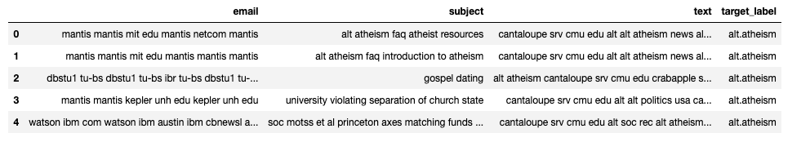
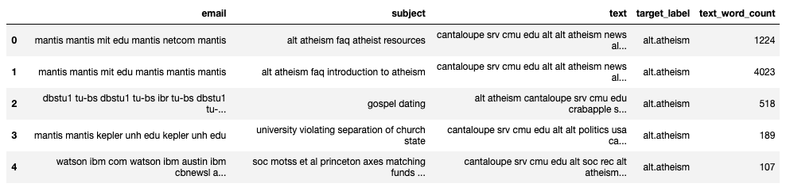
Processed Data

Slide 8
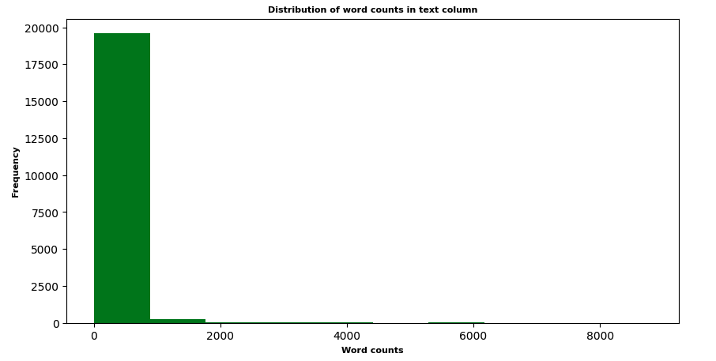
Counting Words
Most of the word count in text column in less than 1000.

Slide 9
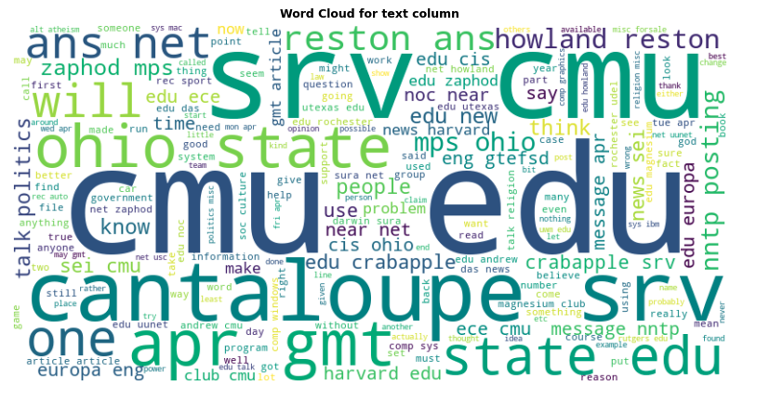
Word Cloud
Ohio State is highly used word in news articles.

Slide 10
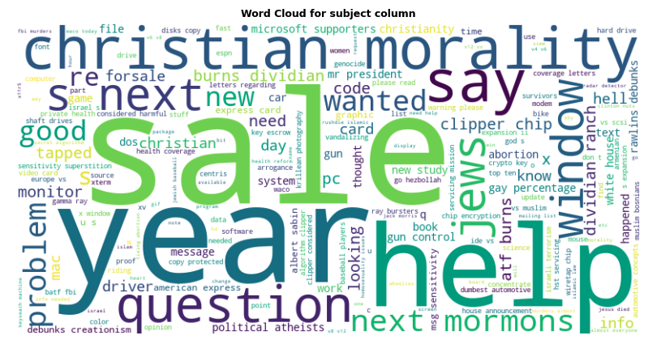
Word Cloud
Sale, year, help are highly used words in subject of news articles.

Slide 11

Train – Test Split
75 – 25% Split.
99% of Word count in Each row <= 1361.
Padding remaining 1% data to 1361 words.

Slide 12
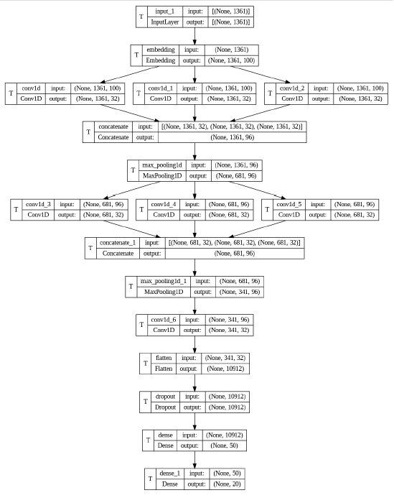
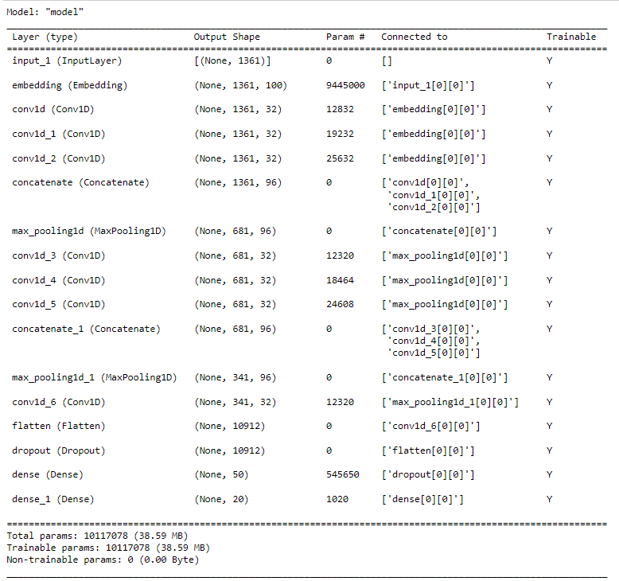
Training using CNN Model
Fig – CNN Architecture
Fig – Model parameters

Slide 13
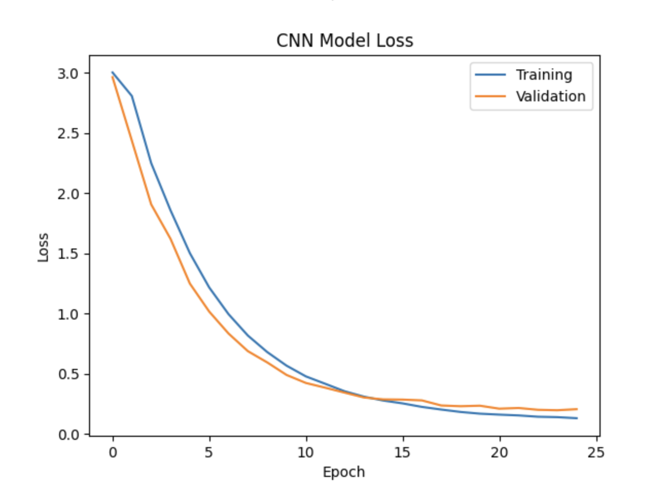
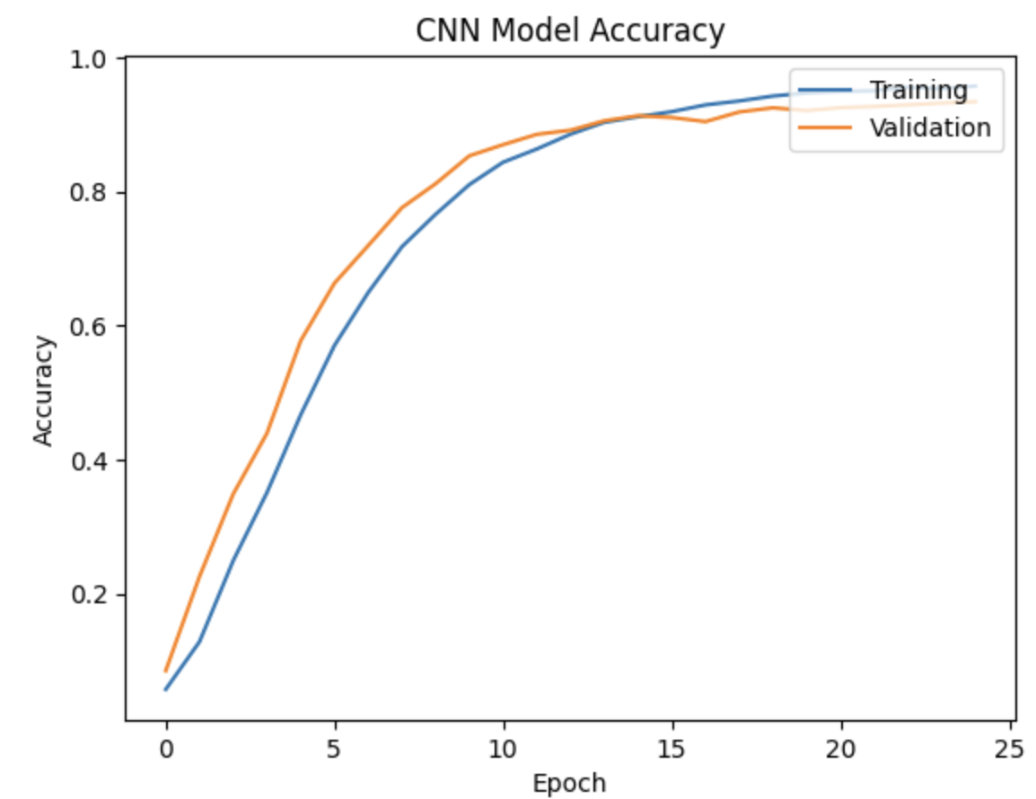
CNN Model Performance
Fig - Train and Test Accuracies of 95% & 93% with out overfitting.
Fig - Train and Test losses of 0.1656 & 0.1485 with out overfitting.

Slide 14
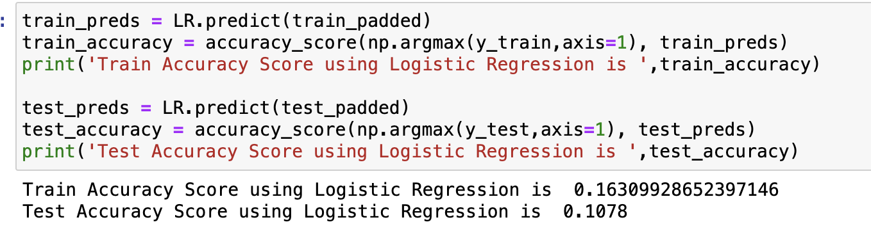
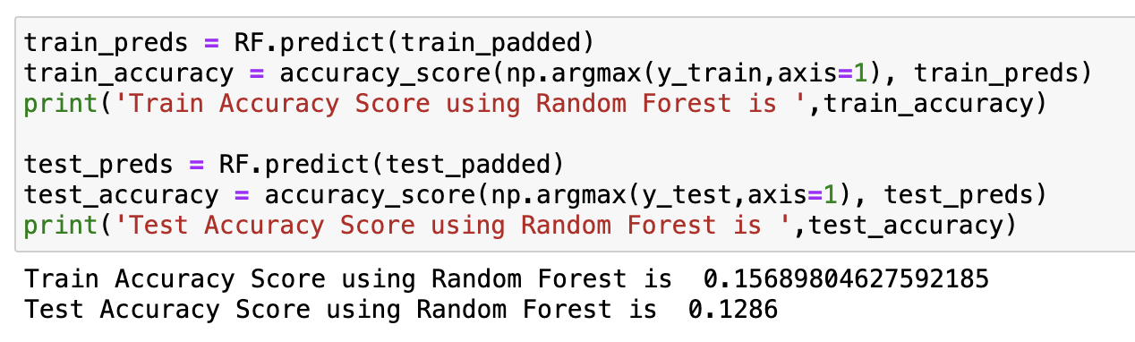
Machine Learning Models
Logistic Regression
Random Forest Classifier

Slide 15
Comparison
Model | Train Accuracy | Test Accuracy
CNN | 0.957 | 0.933
Logistic Regression | 0.163 | 0.1
Random Forest | 0.156 | 0.128

Slide 16
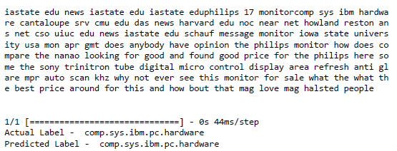
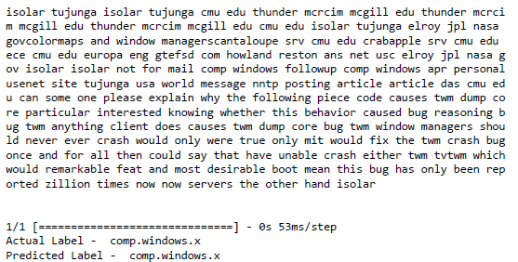
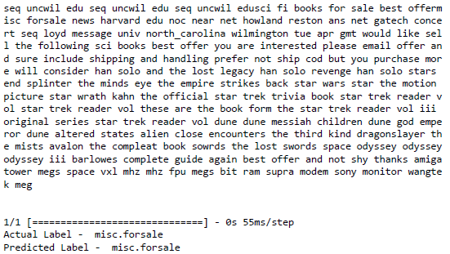
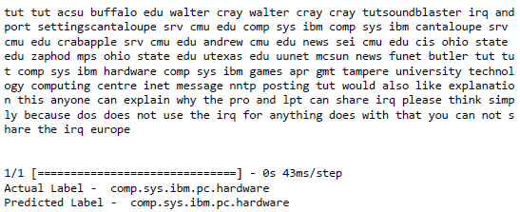
Predictions

Slide 17

Conclusion
CNN model outperformed both Logistic Regression & Random Forest in terms of Accuracies.

Slide 18

Thank You

